Slide 1
Exploring the relationship between heart-disease mortality rates and the financial situation in the U.S
Presenters: Kenny, Jennifer, Linyu(Mike), Lynn
Date: December 1st, 2025

Slide 2
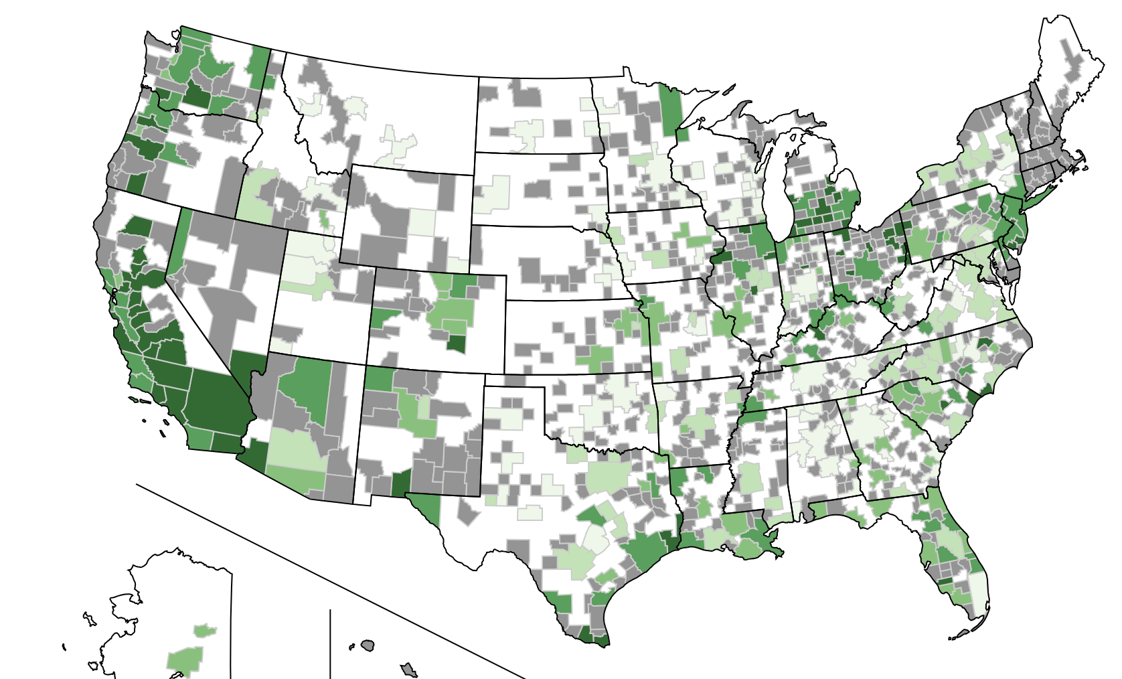

Introduction
I. Heart disease is one of the leading cause of death in the U.S¹.
II. We think many existing researches focus on demographics ex: age, race, or medical factors;
— but less on financial indicators, ex: how economic performance (GDP growth) or financial security (income stability, market volatility) relate to heart-disease mortality.
Heatmap: US unemployment rate 2025
What financial factors have an impact on heart disease mortality rate?
¹ CDC (2023), Heart Disease Facts

Slide 3


Hypotheses:
Research Question:
How do financial conditions — specifically income, local economic stress, and financial market volatility — affect age-adjusted heart disease mortality rates in the U.S.?
H1: County-level economic stress—measured by GDP growth, unemployment, and uninsured rates—is linked to age-adjusted heart-disease mortality in the U.S.
H2: Counties (or states) with higher median household income have lower age-adjusted heart disease mortality rates.
H3: Greater exposure to market volatility is linked to bigger rises in heart-disease mortality during economic crises.
aaaaaaaaaaaaaaaaaaaaa
Analysis:
County groups cross comparison on independent variables;
Trend analysis
Correlation analysis
Distribution analysis
Predictive analysis
Machine learning.

Slide 4
Dataset selection for analysis
Independent variable
Dependent variable
Time variable
County/State median income
Market volatility index
GDP growth rate
Year
County uninsured rate
Heart disease mortality rate
County unemployment rate
Select those dataset to evaluate how different forms of financial stress relate to heart-disease mortality over time.
Use year as a time dimension to observe trends and changes over time.

Slide 5
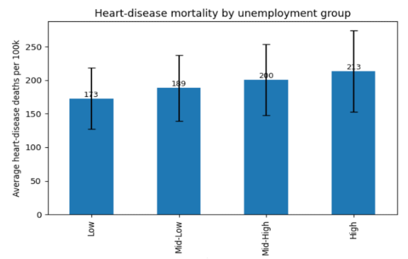
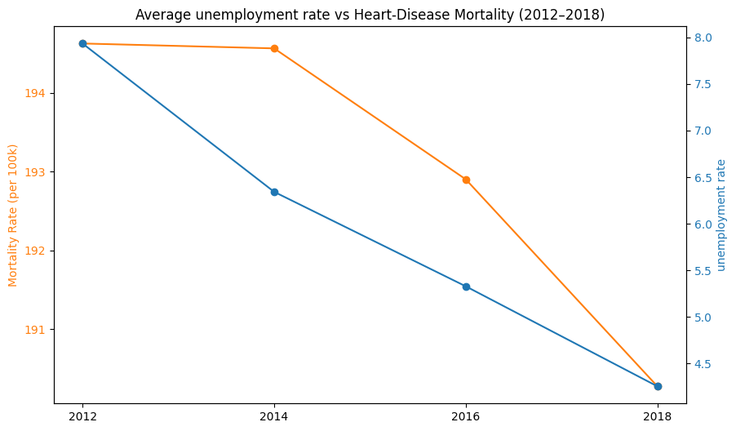
Findings– H1(1) Local Economic Stress-Unemployment rate
1. Divide the unemployment dataset into 4 equal-sized groups (Low/Mid-Low/Mid-High/High) for each economic factor.
2.Trend analysis (year-over-year averages)
This initial analysis may support the hypothesis that unemployment is meaningfully associated with heart-disease mortality risk.
When unemployment is divided into four equal-sized groups (Low → High), the average heart-disease mortality increases steadily:
Low unemployment counties: 173 deaths per 100k
High unemployment counties: 213 deaths per 100k

Slide 6
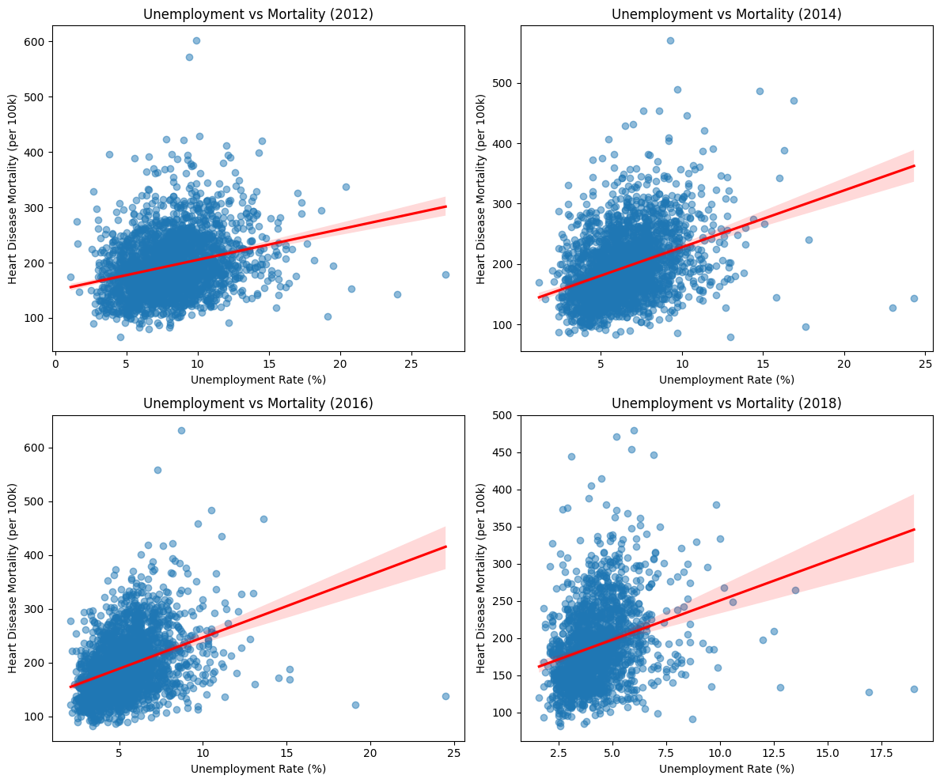
When we look for the county-level at each different four years:
we still observes a consistent positive association between unemployment and heart-disease mortality
However, this relationship was not as strong as we initially anticipated.
Our Conclusion
Unemployment is one of multiple factors influencing heart-disease outcomes, rather than a dominant predictor.

Slide 7
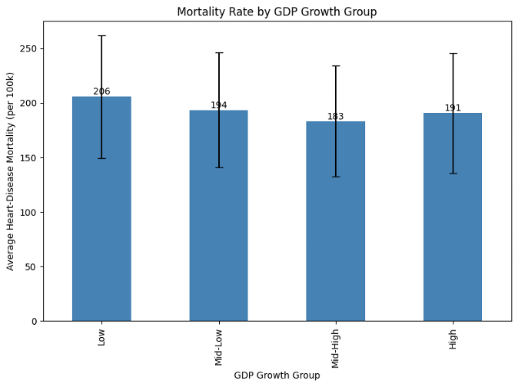
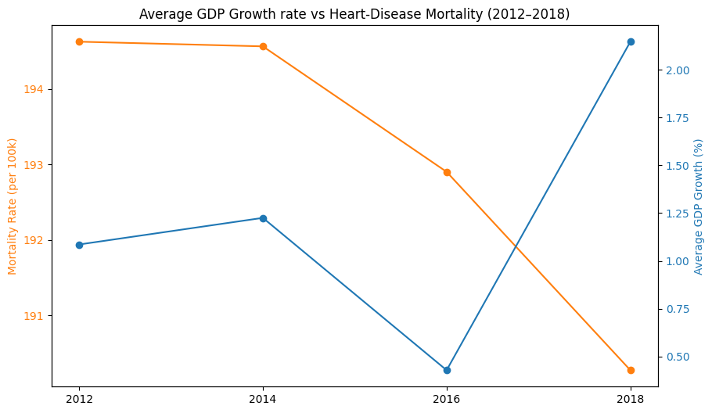
Findings– H1(2) Local Economic Stress - GDP growth rate
Low GDP-county group: 206 deaths per 100k
High GDP-county group: 191 deaths per 100k
Heart-disease mortality gradually declines from 2012 → 2018 while GDP growth fluctuated irregularly.
GDP growth rate does not follow the expected direction
We conclude that the GDP growth showed the weakest association with heart-disease mortality
We anticipate this may be an inverse relationship.. But?

Slide 8
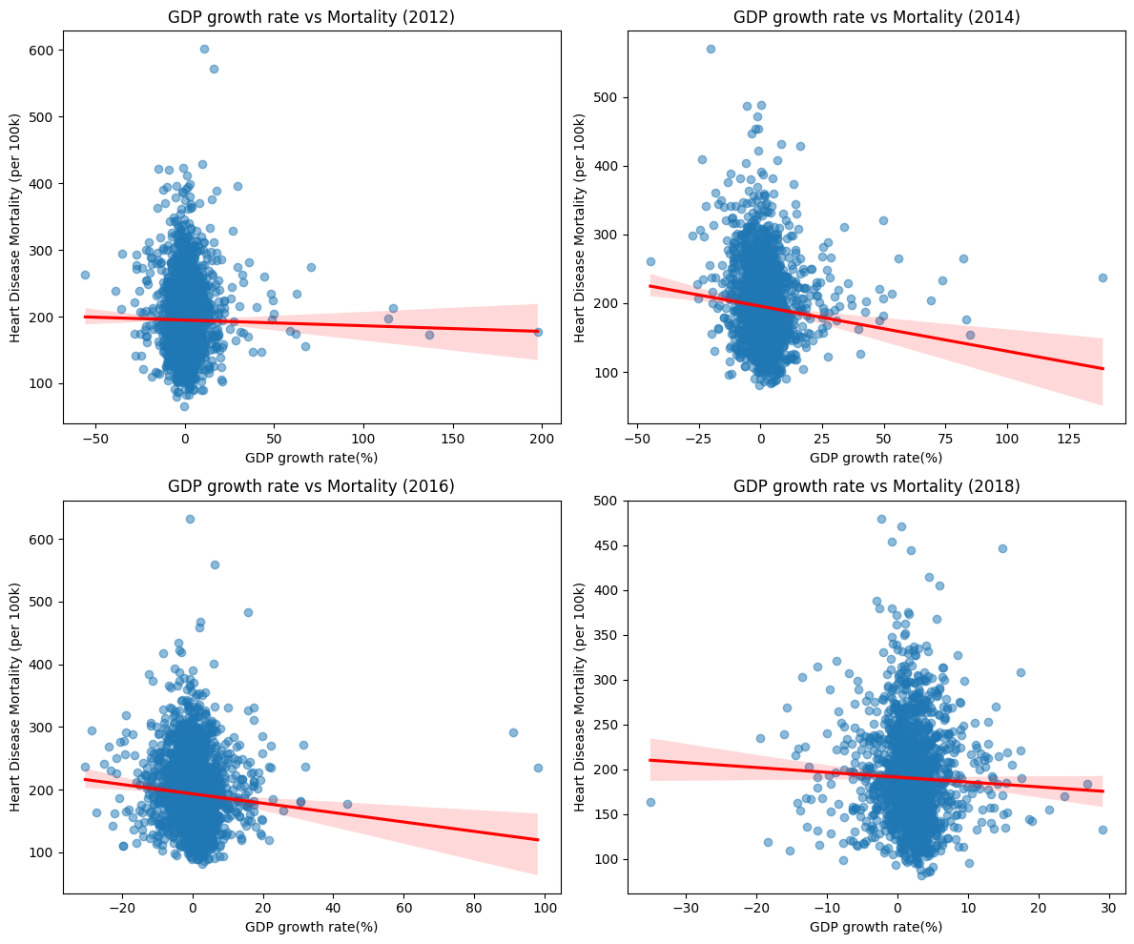
For each county-level GDP growth rate at different years:
Higher GDP growth may be associated with slightly lower heart-disease mortality. e.g. rich counties may experience better health outcomes due to greater investment in healthcare and public service.
However, this relationship was extremely week (much weaker than unemployment rate)
Our Conclusion
GDP growth explains very little of the variation in mortality

Slide 9
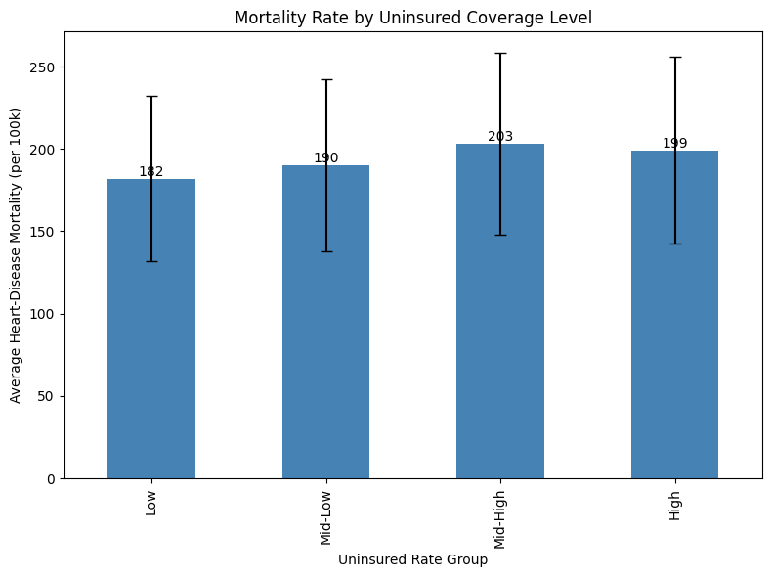
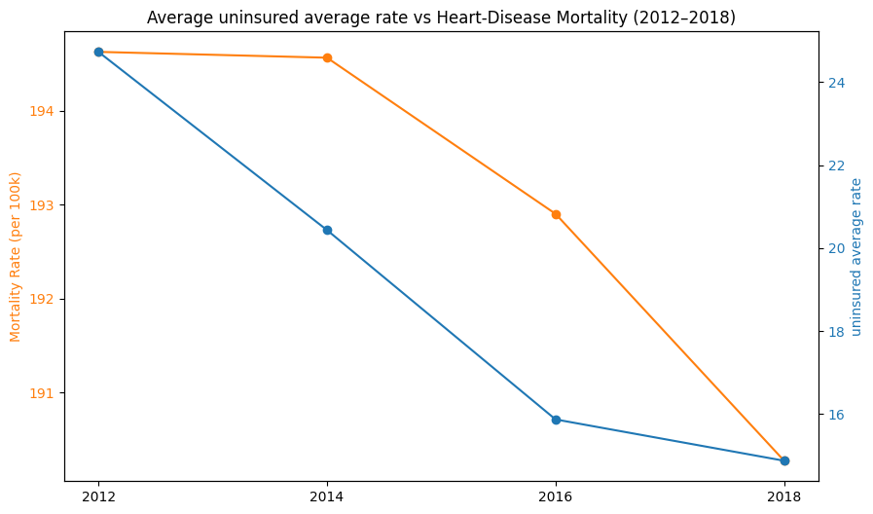
Findings– H1(3) Local Economic Stress - Uninsured coverage rate
Both the uninsured rate and heart-disease mortality steadily decline from 2012 to 2018.
Uninsured rates fall sharply while mortality drops only slightly
Low uninsured-county group: 182 deaths per 100k
High GDP-county group: 199 deaths per 100k
Initial thought
Lower uninsured rates may contribute to better health outcomes, but the effect is modest

Slide 10
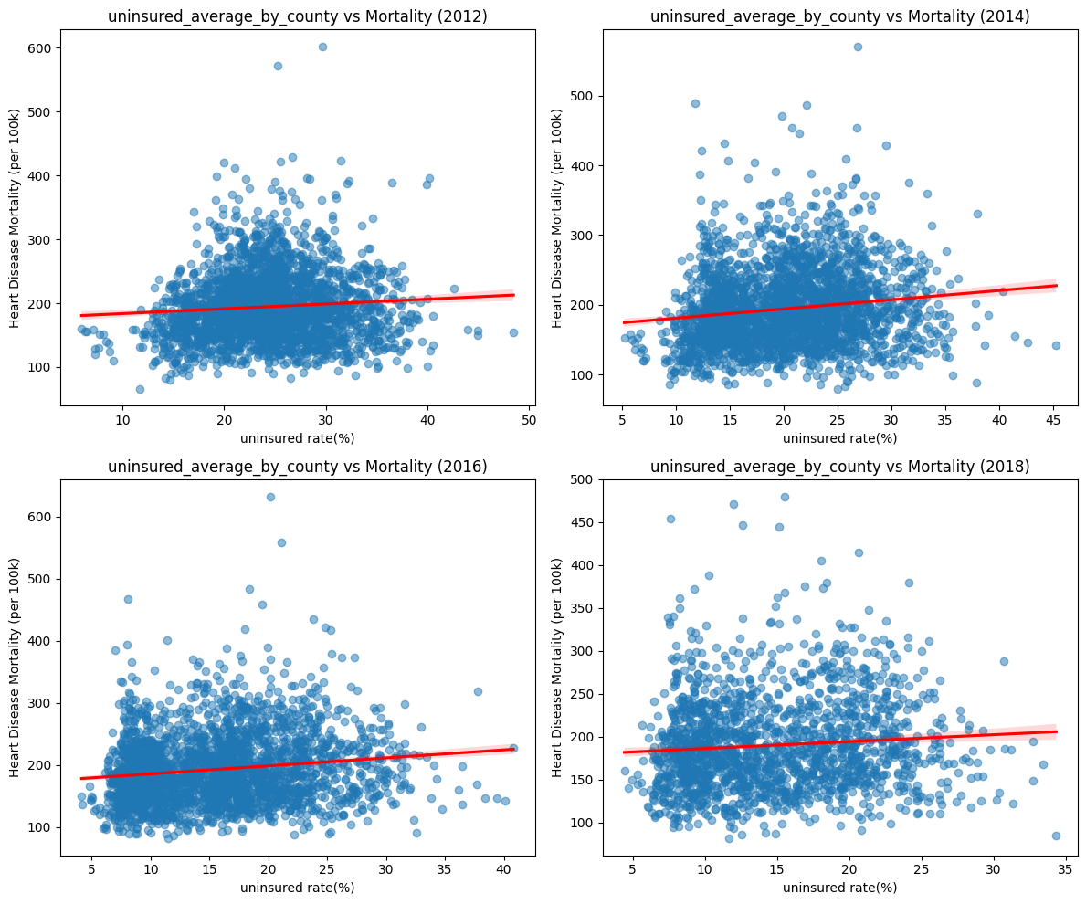
For each county-level uninsured rate at different years:
Counties with higher uninsured rates tend to have slightly higher heart-disease mortality
This relationship is still considered as week, but it has a clearer (though still modest) pattern than GDP.
Our Conclusion
While lack of insurance may contribute to poorer health outcomes, it is only one of several factors influencing county-level mortality.

Slide 11
Top 5 Highest-Mortality Counties vs. Top 5 Lowest-Mortality Counties
County (Year) | Mortality Rate (per 100k) | Unemployment Rate (%) | GDP Growth (%) | Uninsured Rate (%)
Franklin Parish, LA (2016) | 632.7 | 8.7 | -0.7 | 20.16
Franklin Parish, LA (2012) | 601.9 | 9.9 | 10.7 | 29.64
Gallatin County, KY (2012) | 572.0 | 9.4 | 16.1 | 25.28
Franklin Parish, LA (2014) | 570.0 | 9.3 | -20.2 | 26.89
Clinch County, GA (2016) | 558.8 | 7.3 | 6.3 | 21.13
Average (Top 5) | 586.7 | 8.9% | 2.44% | 24.62%
County (Year) | Mortality Rate (per 100k) | Unemployment Rate (%) | GDP Growth (%) | Uninsured Rate (%)
Nicollet County, MN (2012) | 66.3 | 4.6 | -0.2 | 11.68
Chisago County, MN (2012) | 79.3 | 6.6 | -4.6 | 14.70
Santa Cruz County, AZ (2014) | 80.2 | 13.0 | -0.3 | 25.03
Douglas County, CO (2018) | 81.8 | 2.6 | 3.4 | 11.69
Lafayette County, WI (2016) | 81.9 | 3.4 | 2.8 | 11.52
Average (Bottom 5) | 77.9 | 6.04% | 0.22% | 14.92%
Counties with the highest heart-disease mortality consistently show higher unemployment, lower economic performance, and significantly higher uninsured rates compared with the counties with the lowest mortality.
Santa Cruz is an outlier, showing low mortality despite high unemployment and a sizable uninsured population.

Slide 12
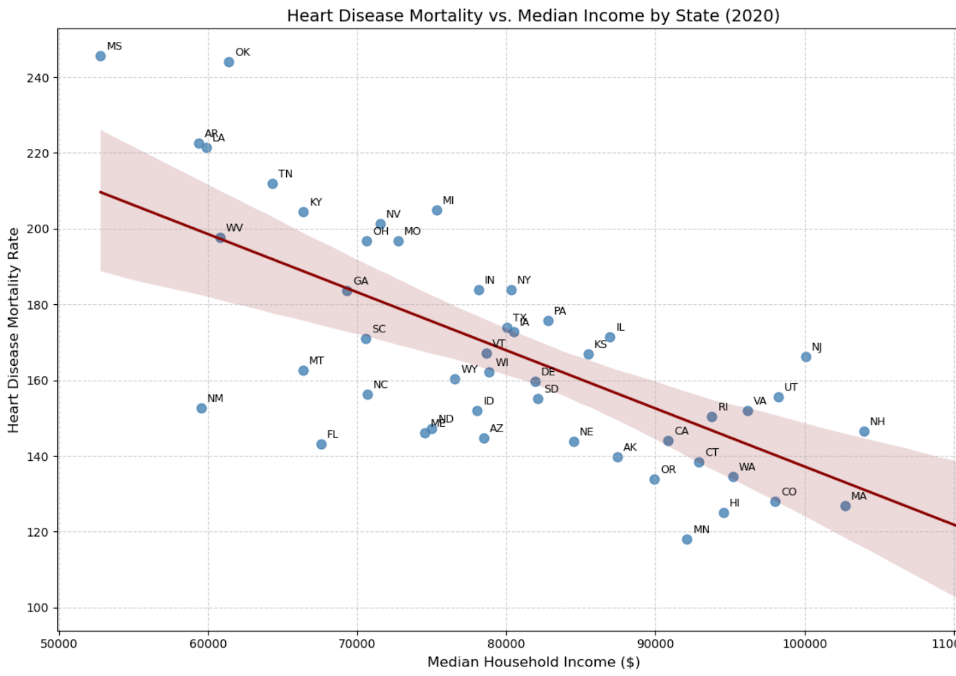
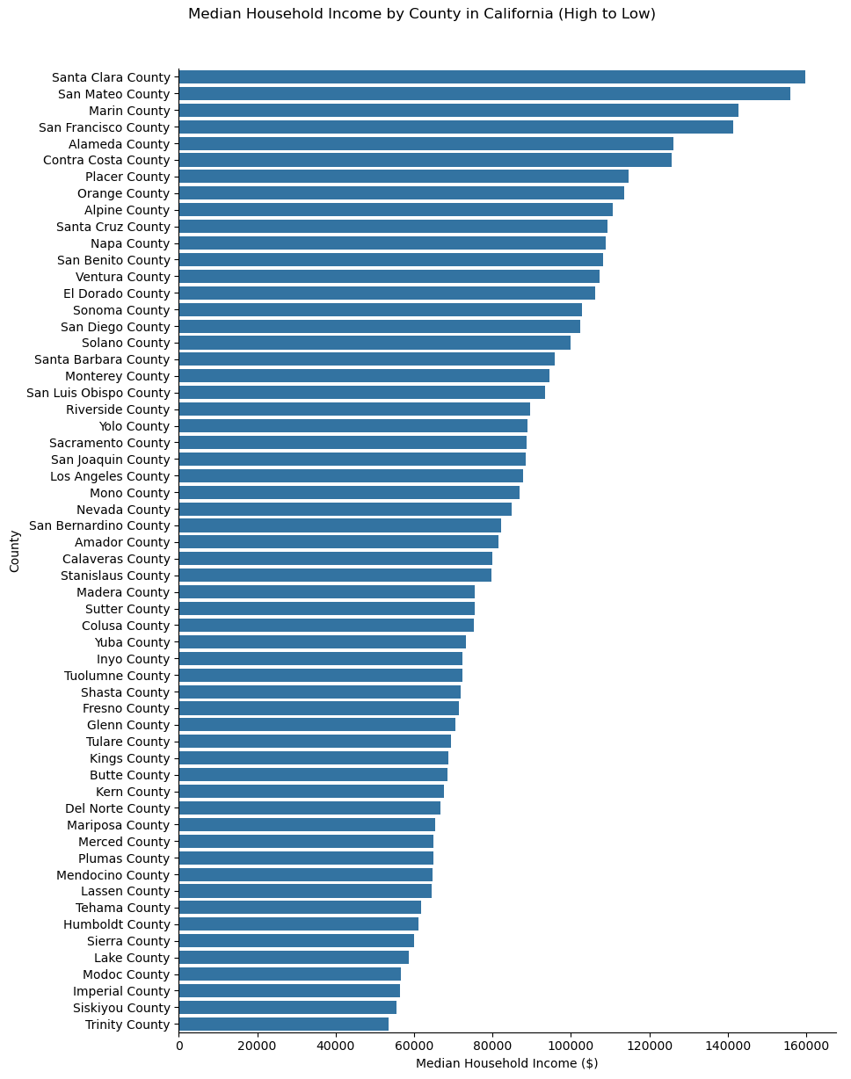
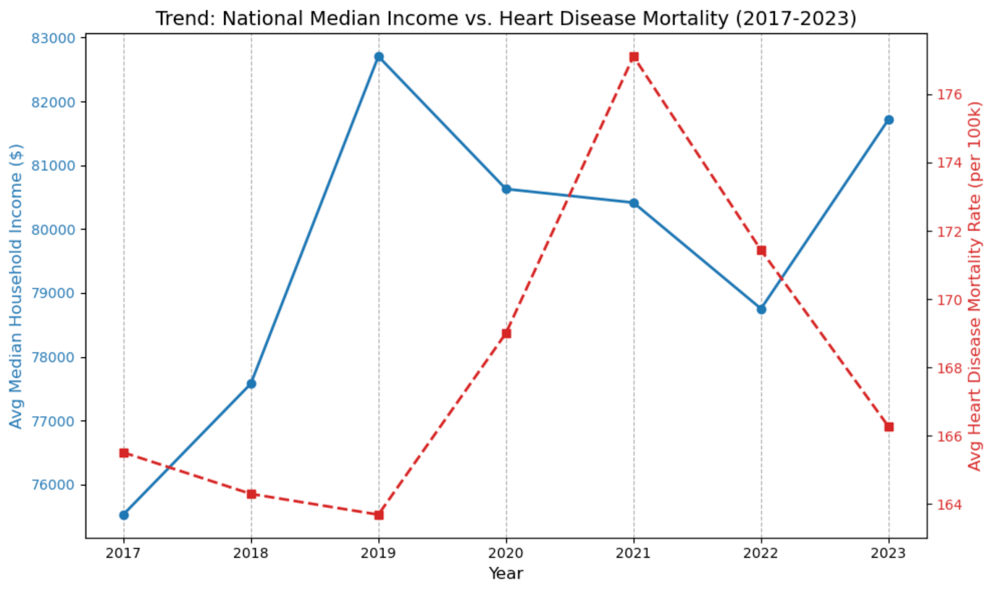
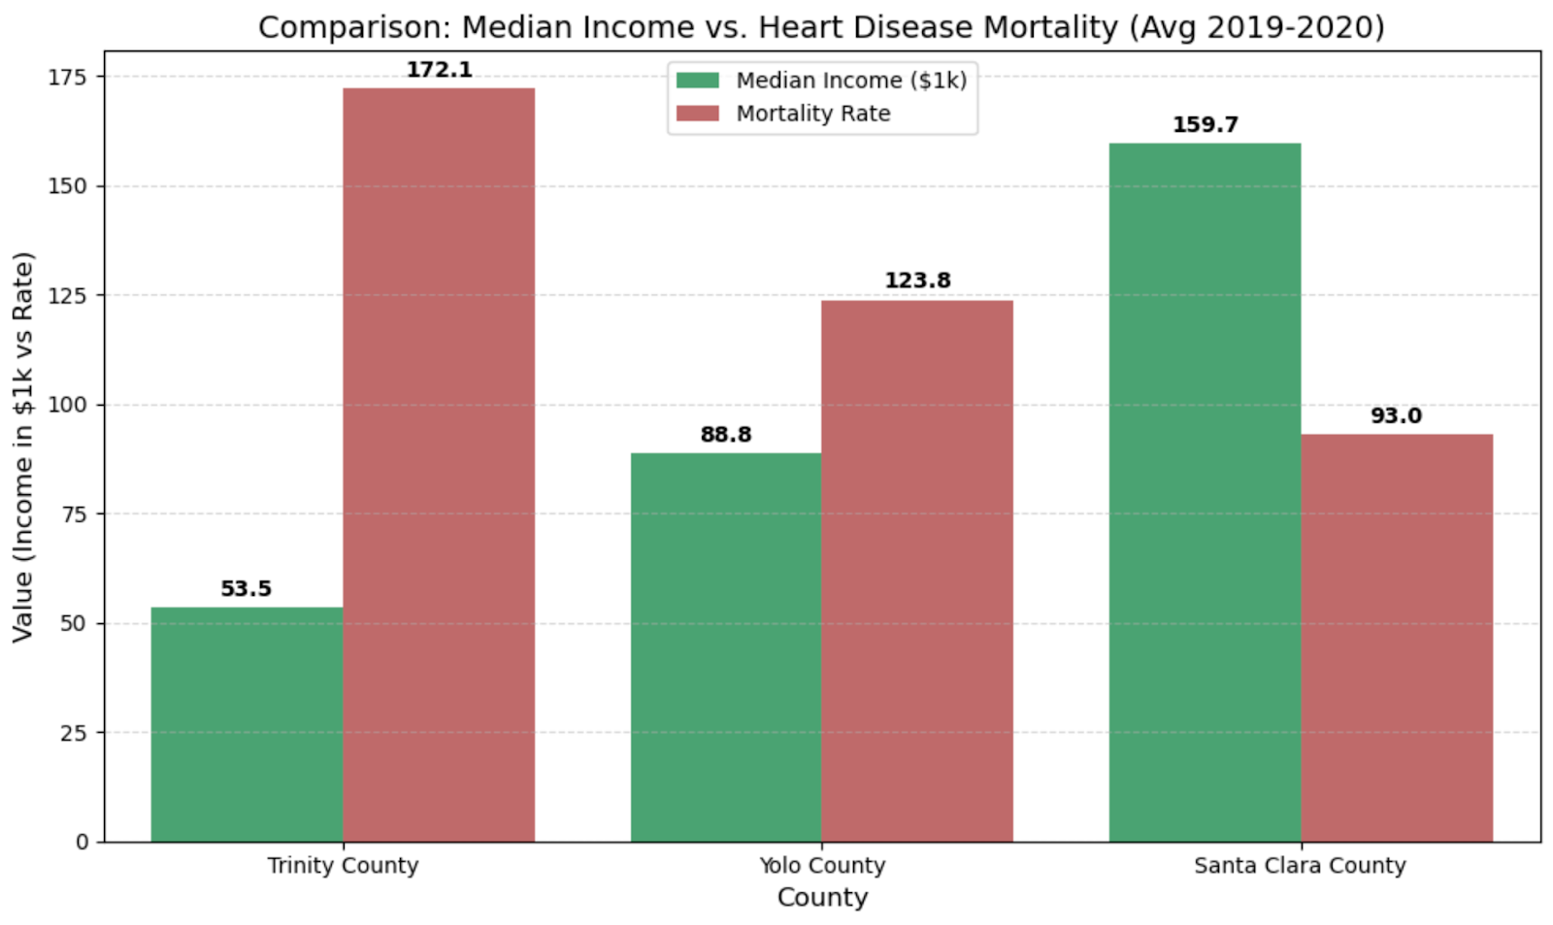
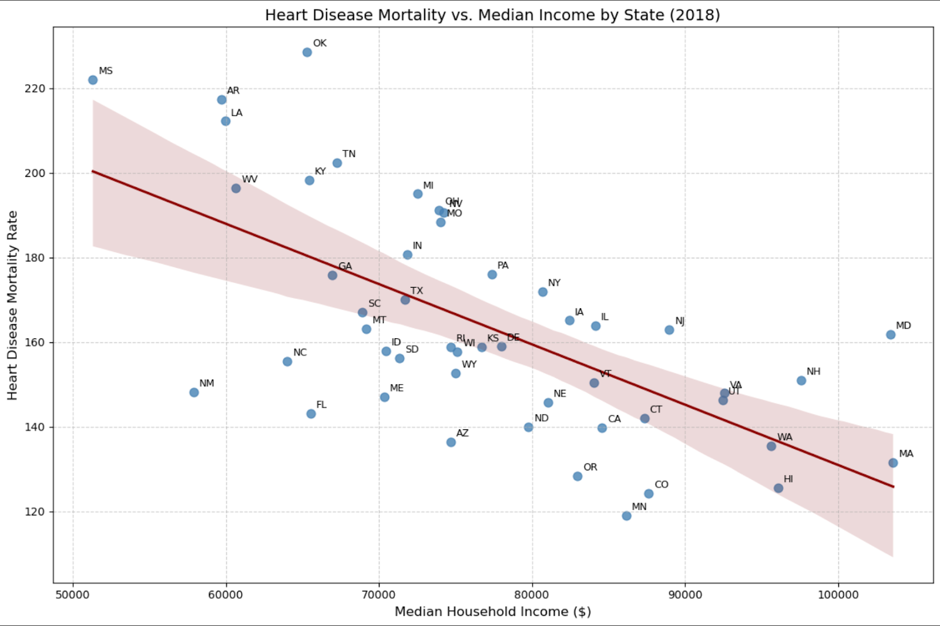
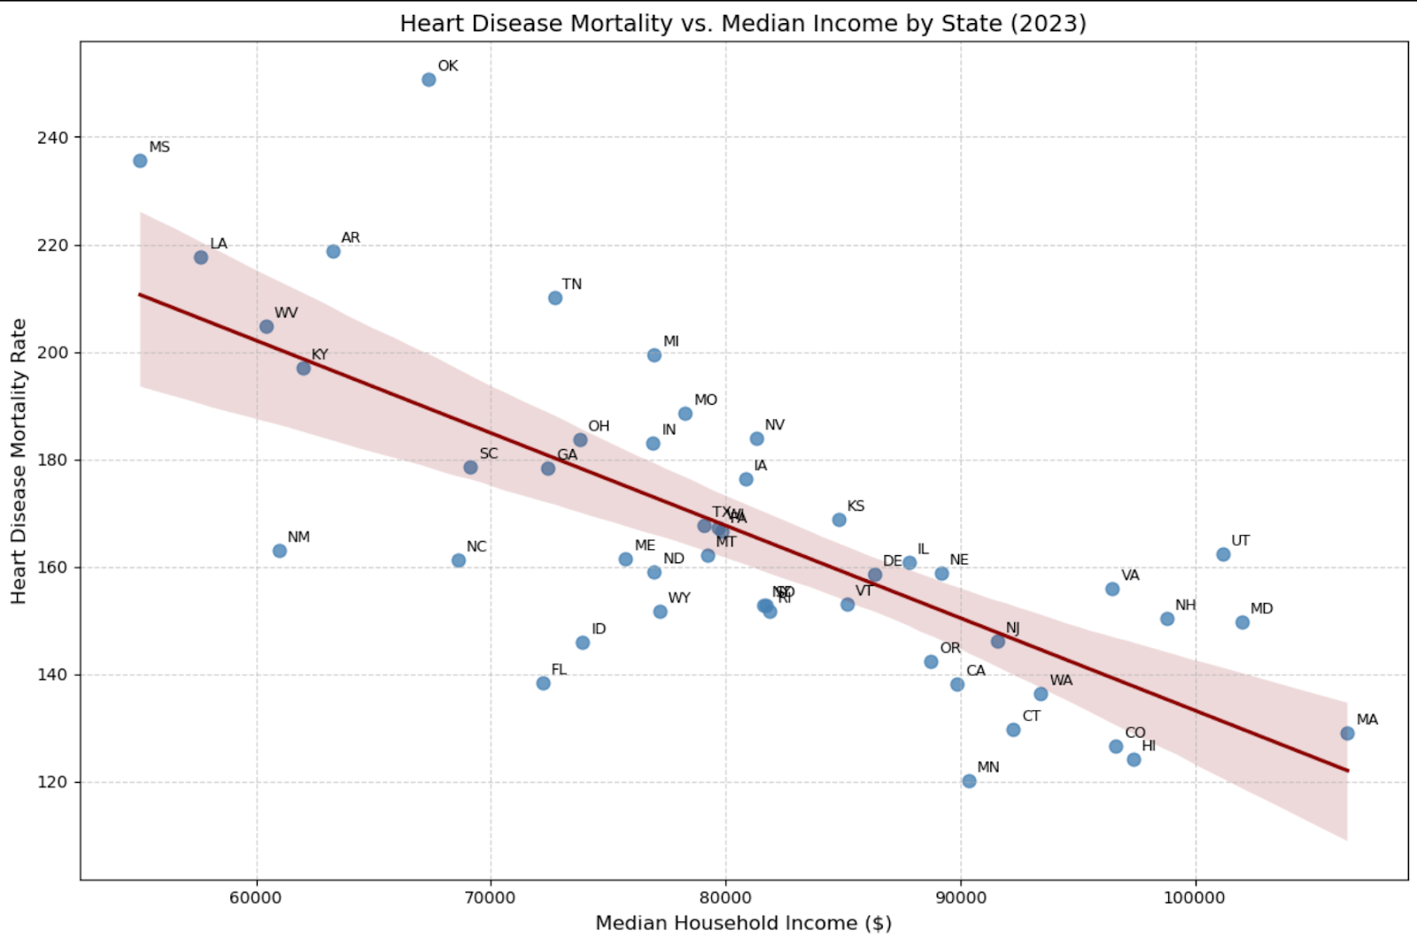
Findings– H2 Heart Disease Mortality and Median Income
H2: Counties (or states) with higher median household income have lower age-adjusted heart disease mortality rates.
1. There’s a negative correlation between median household income and heart disease mortality.
2. 2019 - 2021: a reverse direction occurred due to COVID; 2022 - 2023: during the recovery from COVID, the median income started rising, while the heart disease mortality rate continued dropping.
Key findings
1
2
3
Analysis
Scatterplot
Line
Bar

Slide 13
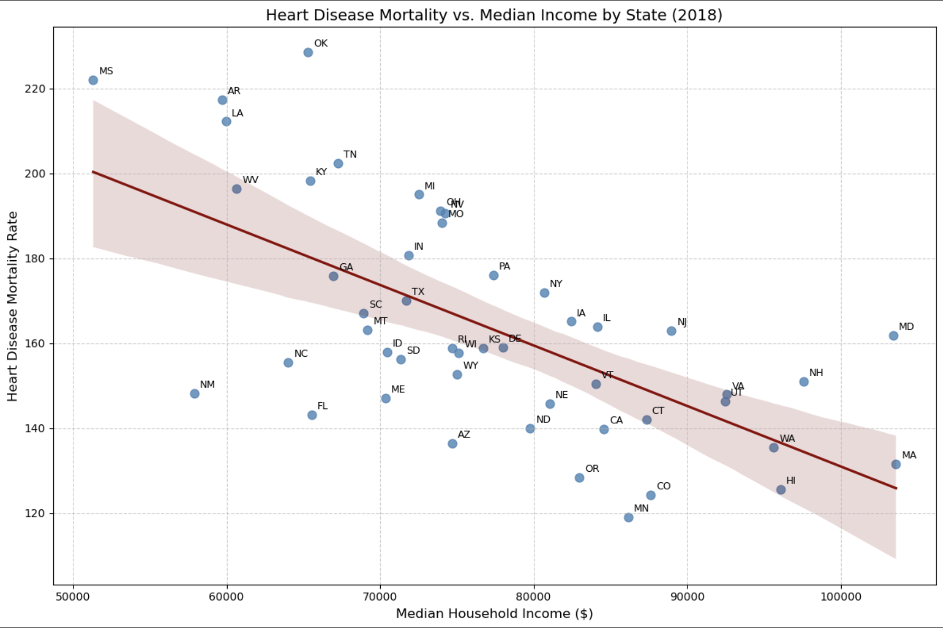
Findings– H2(1) Heart Disease Mortality and Median Income Across U.S. States
The analysis uses pooled observations from all 50 states across three years—2018, 2020, and 2023—which represent the pre-COVID, COVID, and post-COVID periods, respectively.
Time: 2018, pre-COVID
Correlation: -0.640

Slide 14
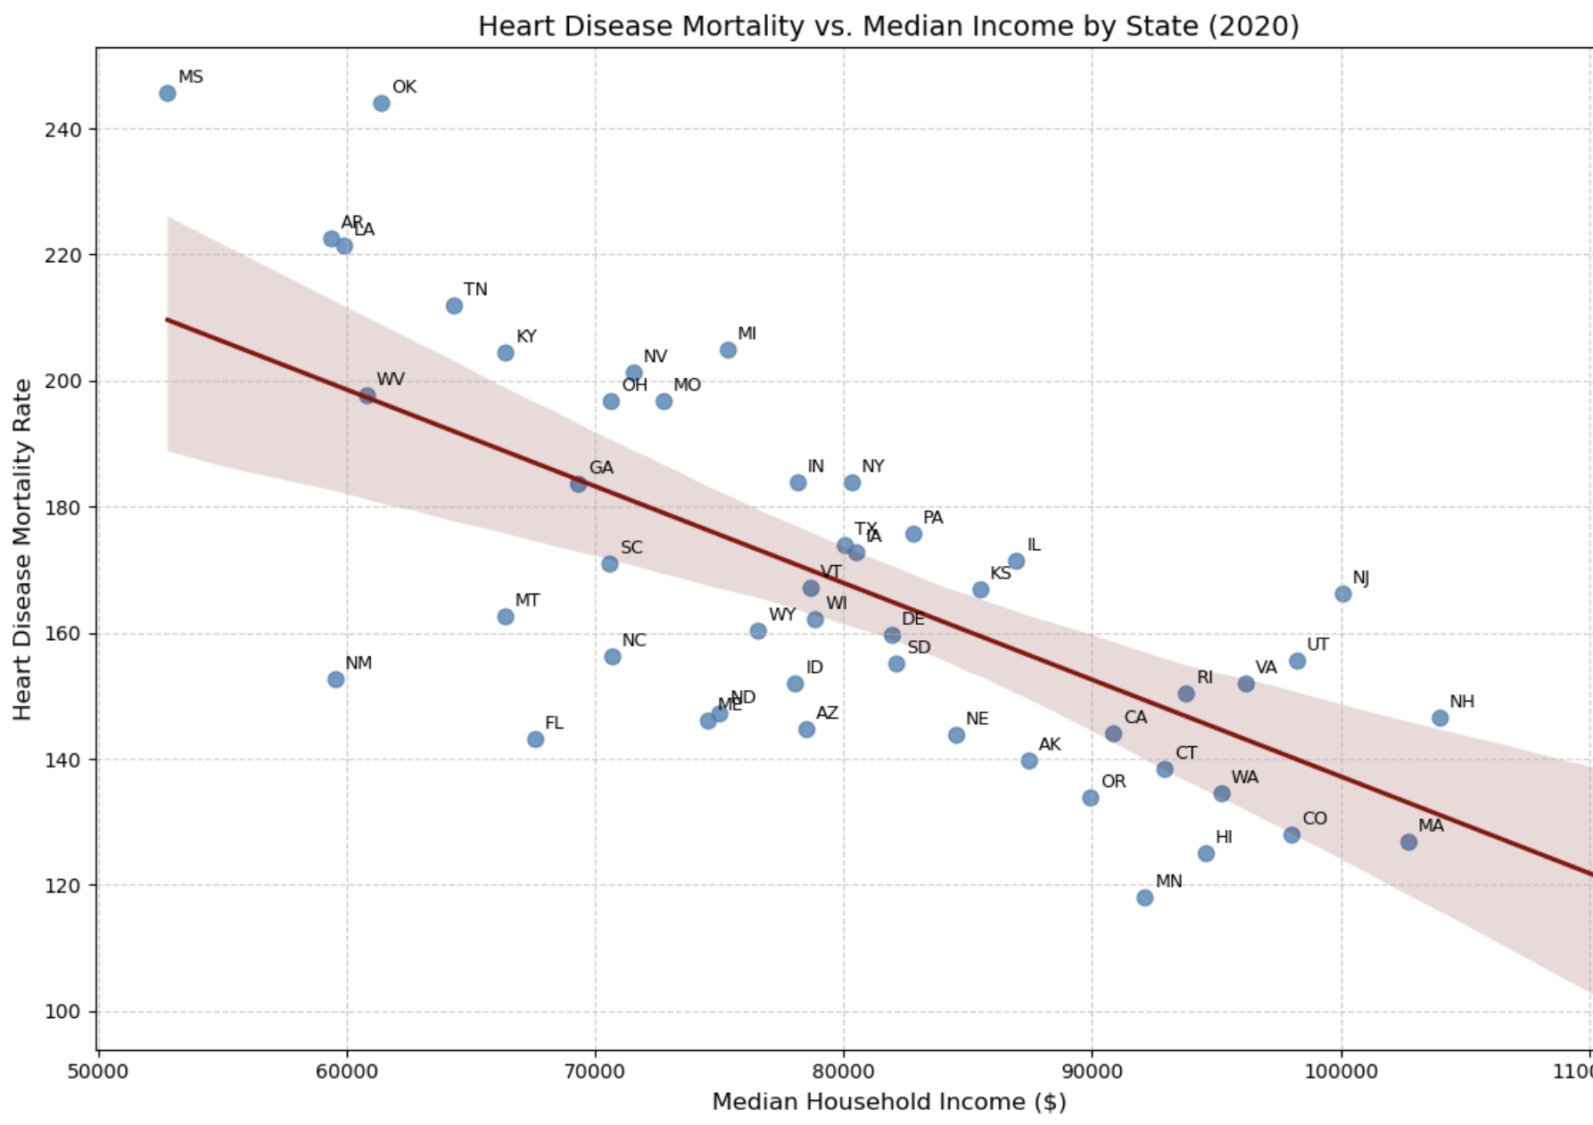
Findings– H2(2) Heart Disease Mortality and Median Income Across U.S. States
The analysis uses pooled observations from all 50 states across three years—2018, 2020, and 2023—which represent the pre-COVID, COVID, and post-COVID periods, respectively.
Time: 2020, during COVID
Correlation: -0.687

Slide 15
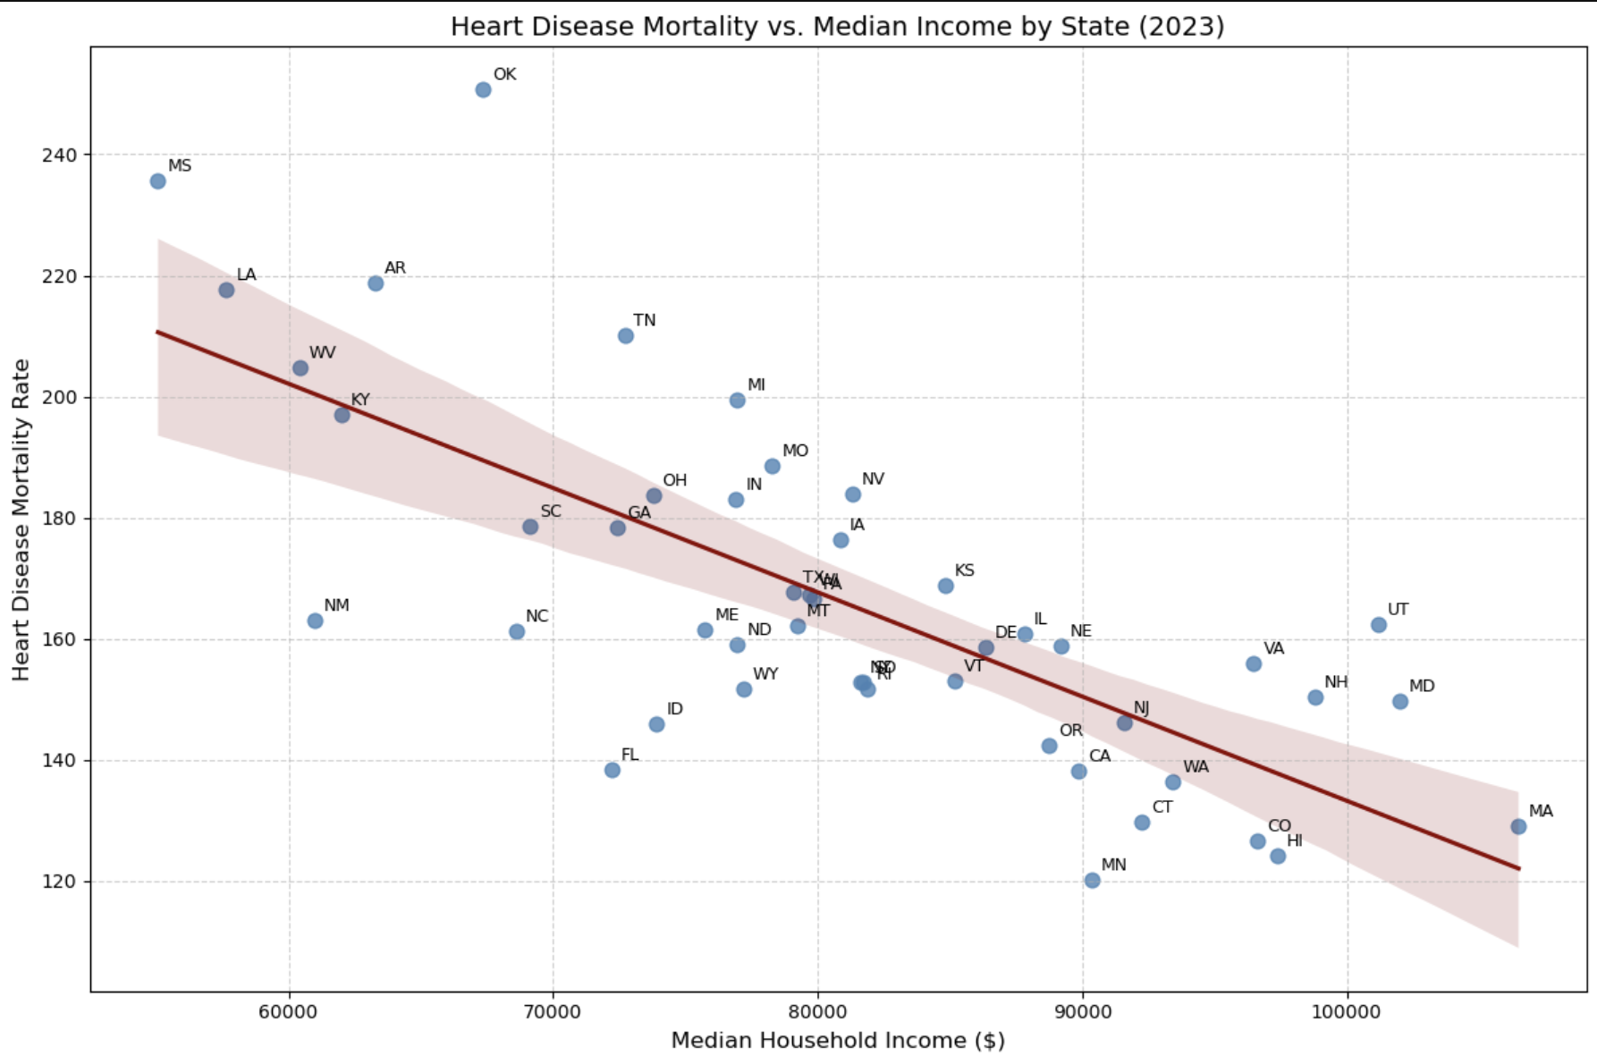
Findings– H2(3) Heart Disease Mortality and Median Income Across U.S. States
The analysis uses pooled observations from all 50 states across three years—2018, 2020, and 2023—which represent the pre-COVID, COVID, and post-COVID periods, respectively.
Time: 2023, post COVID
Correlation: -0.733
Strengthening Inverse Relationship
COVID-19 amplified existing inequalities, making income a stronger predictor of heart disease mortality over time.
Correlation Strength
2018: –0.64 → 2020: –0.69 → 2023: –0.77

Slide 16

Findings– H2(4) Heart Disease Mortality and Median Income (National Lv.)
The analysis uses pooled observations from all 50 states and heart disease mortality rate across the year from 2017 to 2023.
Generally, the lines move in opposite directions, indicating the negative correlation.
2019: median income hit the peak before COVID.
2019 - 2021: a reverse direction occurred due to COVID.
2021 - 2022: both decreased as people started taking more care of their health.
2022 - 2023: during the recovery from COVID, the median income started rising, while the heart disease mortality rate continued dropping.

Slide 17

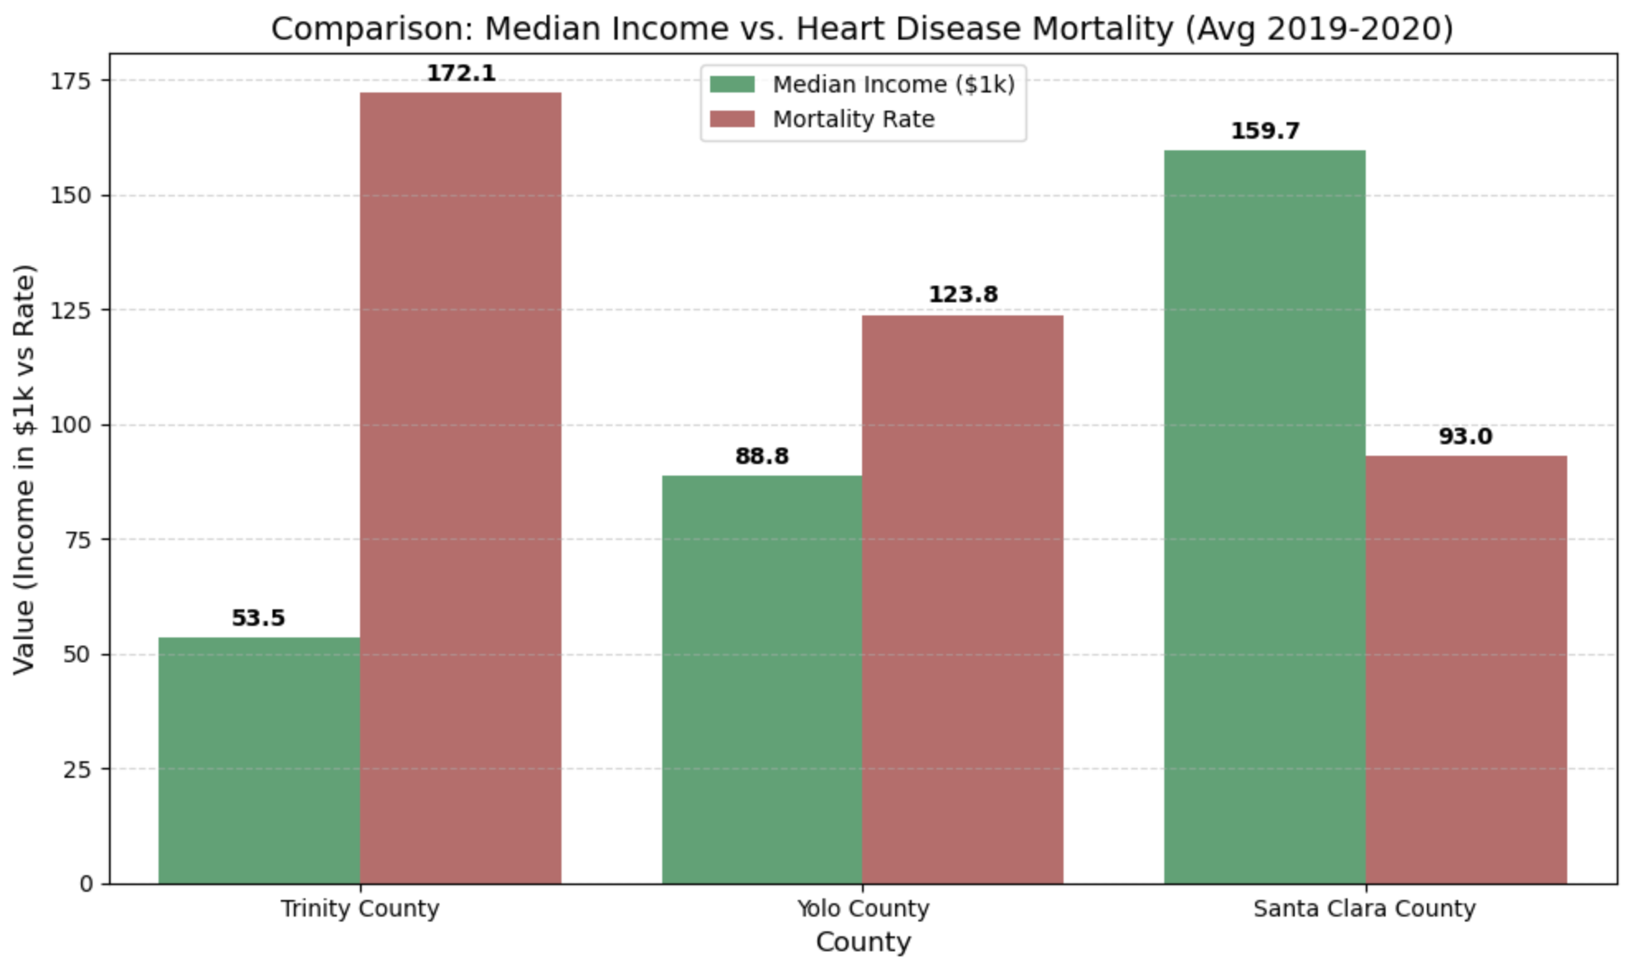
Findings– H2(5) Heart Disease Mortality and Median Income (Counties)
We also observe that this inverse relationship exists at the county level.

Slide 18
Results– H2 Heart Disease Mortality and Median Income
Growing disparities between rich and poor
COVID-19 hit lower-income groups harder, increasing stress and health risks.
i.e. rich people have a better health insurance plan, better treatment, and more sources to prevent illnesses.

Slide 19
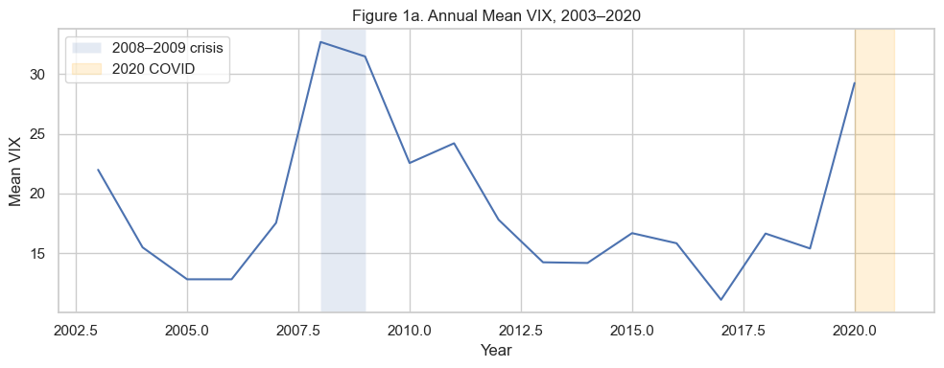
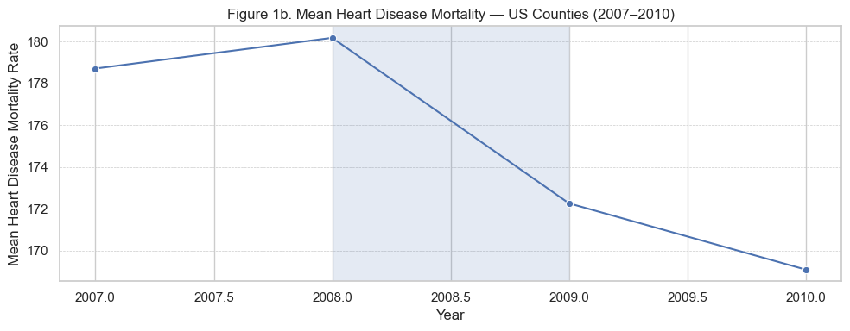
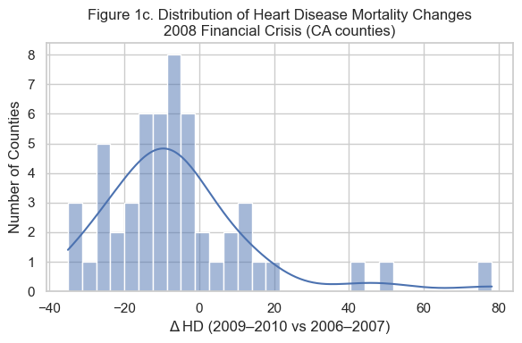
H3: Heart Disease Mortality Around the 2008 Crisis
VIX (Volatility Index)
proxy for systematic financial stress
Mean mortality pattern
US county heart disease mortality drops sharply (2008)
Mortality continues falling into 2010, suggesting an overall downward trend.
The decrease during the 2008–2009 crisis contradicts expectations of stress-induced mortality spikes.
Distribution of CA counties changes
Most California counties experienced flat or declining mortality (mass is ≤ 0).
The distribution is left-skewed, meaning declines were more common than increases.
Pattern implies strong county-level heterogeneity in how crisis translates into health outcomes

Slide 20
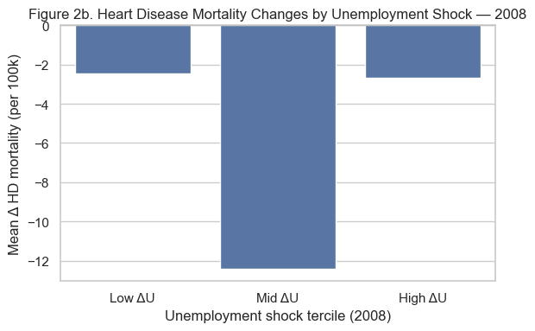
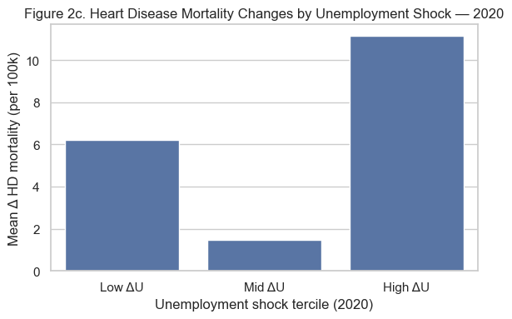
H3: Heterogeneity by Unemployment Shock Tercile
Simple descriptive comparison of crisis exposure vs. mortality changes
Two bar charts (2008 vs 2020): For each crisis, compare mean ΔHD in low, mid, and high ΔU terciles.
2008: All terciles show declines, and mid-shock counties drop the most → weak/non-monotonic link between unemployment shocks and mortality.
2020: High-shock tercile shows the largest increase, low-shock moderate increase, mid-shock small change → stronger, monotone link in COVID.
2020 looks more tied to unemployment. Can we predict which counties worsen using ML models?

Slide 21
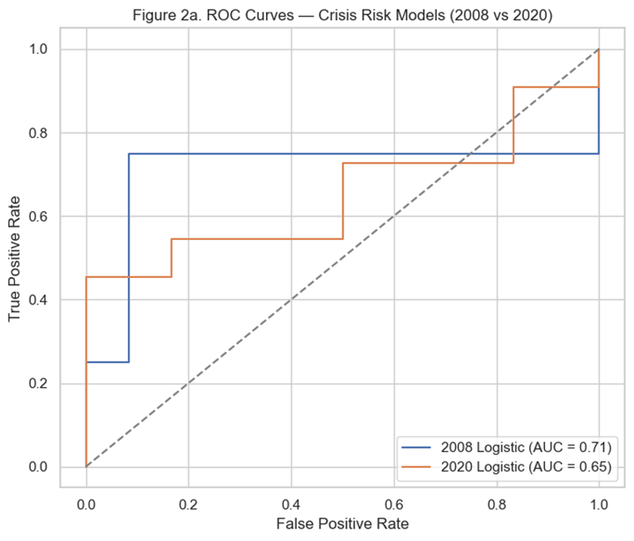
H3: Crisis Risk Models: ROC Curves
Do ML models actually have any predictive signal, and is one crisis easier to predict than the other?
ROC Curve
Shows the models are better than random
above 45 degrees line
Quantifies “how much better” (AUC)
2008: moderate discrimination (~0.71)
2020: weaker but non-trivial discrimination (~0.65)
Compare crises
same feature set (pre-crisis HD, pre-crisis unemployment, and the unemployment shock), the 2008 crisis is somewhat more predictable than the 2020 COVID shock
False Positive Rate: how many safe counties incorrectly flag
True Positive Rate: how many truly “worsening” counties correctly flag
Models can pick up some risk. What features are they actually using?

Slide 22
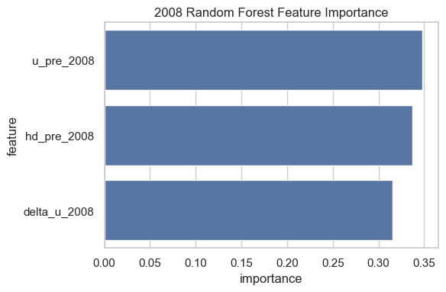

H3: Random Forest Feature Importance — 2008 vs 2020
What drives model predictions in each crisis?
In both 2008 and 2020, all three features (pre-crisis mortality, pre-crisis unemployment, and the unemployment shock ΔU) have very similar importance in the random forest.
This suggests that baseline vulnerability and crisis intensity both matter; no single predictor dominates.
The small differences in bar height likely reflect sampling noise, so the main takeaway is that each feature contributes meaningfully to predicting which counties worsen.

Slide 23
H3: Key Takeaways and Limitations
Both the 2008 financial crisis and the 2020 COVID shock produced macro volatility spikes, but national heart disease mortality did not explode.
Machine-learning models (logistic, random forest) can moderately predict which counties see worsening outcomes, using pre-crisis risk levels and unemployment shocks.
Counties with worse starting conditions and larger labor-market shocks are more likely to experience an increase in heart-disease mortality during macro crises
Results are exploratory: data are limited to selected years and mainly California counties; no individual-level controls or causal identification.

Slide 24
Our Three Findings
Finding 1: Economic Stress
Finding 2: Median Income
Finding 3: Volatility
Among the three economic indicators, unemployment consistently shows the strongest and clearest relationship with heart-disease mortality. In contrast, the local uninsured rate and GDP growth are weakly associated with mortality.
Across states, counties, and national data, higher median income is strongly associated with lower heart-disease mortality, making income a powerful financial predictor in our study.
Economic shocks create volatility, but heart-disease mortality does not automatically spike. Risk depends more on baseline vulnerability (existing health conditions, pre-crisis mortality) and the severity of the local unemployment shock.

Slide 25
Managerial Insights - ‘So What?’
Using Unemployment Trends to Guide Health Planning
Income & Heart Disease: A Clear Strategic Signal
Crisis-Specific Health Planning for Better Outcomes
Policymakers and healthcare planners should treat unemployment as an early signal of future health burdens, not merely a labor-market metric.
Healthcare systems should allocate extra resources (staffing, preventive outreach) during periods of rising unemployment.
Investing in economic support, job stability, and preventive care could reduce long-term healthcare costs and improve community well-being.
Resource allocation must be prioritized for low-income areas.
High-income areas should be targeted with premium wellness and elective services.
Organizations can use these income–mortality insights to refine underwriting, choose better facility locations, and design products that match local needs.
.
Financial-market crises (e.g., 2008)
Don’t cut long-term prevention programs during volatility or rising unemployment.
Heart-disease mortality stayed stable in past financial crises, so prevention efforts should be maintained or expanded.
Health-disrupting crises (e.g., COVID)
Treat unemployment spikes as early warnings of worsening health outcomes.
Pre-position resources—telehealth, medication outreach, screening, and support programs—in the hardest-hit areas.

Slide 26
Thank you!
—
Q&A

